Slide 1

Microservices
M.Sc. IT Part1
Roll No : 272
Shruti Basutkar

Slide 2
What are microservices?
Microservices - also known as the microservice architecture - is an architectural style that structures an application as a collection of services that are :
Highly maintainable and testable
Loosely coupled
Independently deployable
Organized around business capabilities
Owned by a small team
The microservice architecture enables the rapid, frequent and reliable delivery of large, complex applications. It also enables an organization to evolve its technology stack.
Microservices are ideal for big systems. It is goal oriented and it focuses on replaceability.
Shruti Basutkar 05/05/21 Pg:02|11

Slide 3
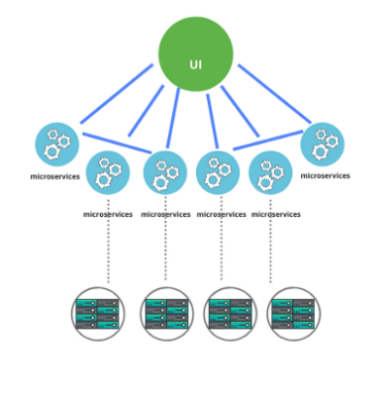
“How would we deal with all the parts? Who is in charge?”
The two concerning microservices characteristics are “Decentralization” and “Autonomy”.
Decentralization means that the bulk of the work done within your system will no longer be managed and controlled by a central body.
Team autonomy means trusting your development teams to make their own decisions about the software they produce.
The key benefit to both of these approaches is that software changes become both easier and faster—less centralization results in fewer bottlenecks and less resistance to change, while more autonomy means decisions can be made much quicker.
Shruti Basutkar 05/05/21 Pg:03|11

Slide 4
When a software is build with decentralization and autonomy, the cost of controlling and managing output increases significantly.
In a microservice architecture, the services tend to get simpler, but the architecture tends to get more complex.
That complexity is often managed with tooling, automation, and process.
Asserting control and management of a microservice system is more expensive than in other architectural styles.
For many organizations, this cost is justified by a desire for increased system changeability.
However, if the return doesn’t adequately outweigh the benefit, chances are this is not the best way to build software in your organization.
Shruti Basutkar 05/05/21 Pg:04|11

Slide 5

Amazon using microservices
The big architectural change that Amazon made was to move from a two-tier monolith to a fully-distributed, decentralized, services platform serving many different applications.
Started as one application talking to a backend written in C++.It grew.
For years the scaling efforts at Amazon focused on making the back-end databases scale to hold more items, more customers, more orders, and to support multiple international sites.
In 2001 it became clear that the front-end application couldn't scale anymore.
Shruti Basutkar 05/05/21 Pg:05|11

Slide 6
The databases were split into small parts and around each part and created a services interface that was the only way to access the data.
The databases became a shared resource that made it hard to scale-out the overall business.
Their architecture is loosely coupled and built around services.
A service-oriented architecture gave them the isolation that would allow building many software components rapidly and independently.
The SOAP web stack is used to solve all the distributed systems problems. It Offer both SOAP and REST web services.
Teams are Small and are Organized Around Services. Eg : Deployment, State Management, etc.
Shruti Basutkar 05/05/21 Pg:06|11

Slide 7
Microservices Way
at
in
Speed & safety
Scale
Harmony
The microservices way is a goal-driven approach to building adaptable, reliable software.
Defined as Speed and Safety at Scale and in Harmony.
The real value of microservices is realized when we focus on two key aspects—speed and safety.
Finding an effective balance between them at scale is what we call the microservices way.
Shruti Basutkar 05/05/21 Pg:07|11

Slide 8
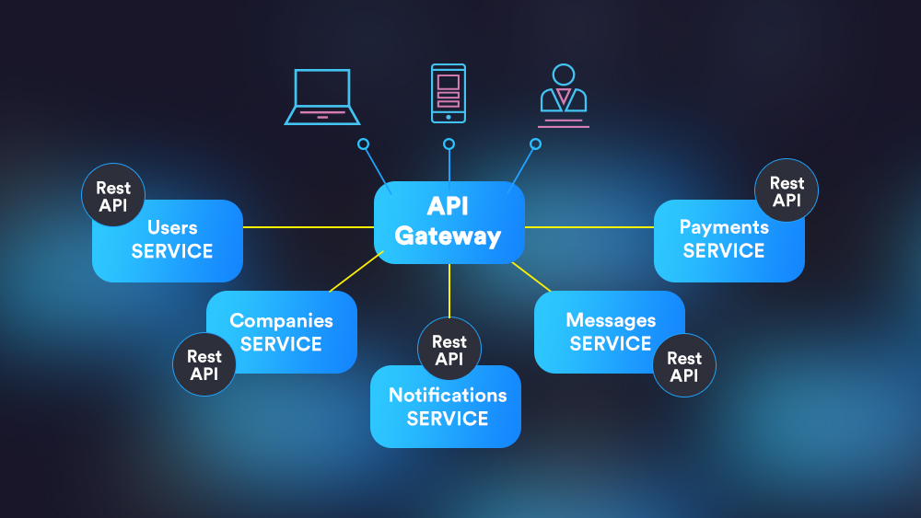
The Speed of change
The desire for speed is a desire for immediate change and ultimately a desire for adaptability.
It is possible to build software that is capable of changing itself— this might require a massive technological leap and incredibly complex system.
The solution that is more realistic for our present state of technological advancement is to shorten the time it takes for changes to move from individual workers to a production environment.
Shruti Basutkar 05/05/21 Pg:08|11

Slide 9
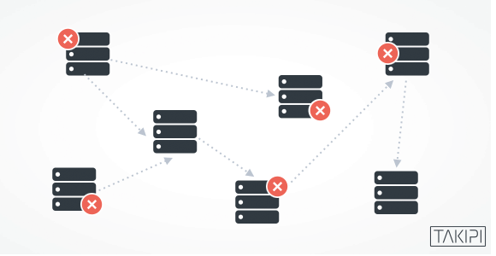
The safety of change
Safety of change is of utmost importance as nobody wants to be responsible for breaking production.
Every change is potentially a breaking change and a system optimized purely for speed is only realistic if the cost of breaking the system is near zero.
Most development environments are optimized for release speed, enabling the software developer to make multiple changes in as short a time as possible whereas , most production environments are optimized for safety, restricting the rate of change to those releases that carry the minimum risk of damage.
Shruti Basutkar 05/05/21 Pg:09|11

Slide 10
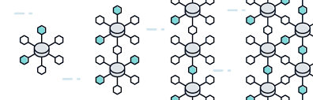
At Scale
The microservices style is rooted in the idea of solving the problems that arise when software gets too big.
To build at scale means to build software that can continue to work when demand grows beyond our initial expectations.
Systems that can work at scale don’t break when under pressure; instead they incorporate built-in mechanisms to increase capacity in a safe way.
This added dimension requires a special perspective to building software and is essential to the microservices way.
Shruti Basutkar 05/05/21 Pg:10|11

Slide 11
In harmony
Microservice architecture is not limited to a simple series of decisions regarding speed and safety of change.
The microservices domain is actually fairly complex and will requires understanding of a wide breadth of concepts that have a great depth of impact.
Organizations that succeed with microservice architecture are able to maintain their system stability while increasing their change velocity.
In other words, they created a harmony of speed and safety that works for their own context.
The speed and safety of changes should co-exist.
Shruti Basutkar 05/05/21 Pg:11|11

